Slide 1
FIR Filter
Chap 10.3

Slide 2
Matlab resource on digital filter design is great especially the DSP System Toolbox!
https://www.mathworks.com/help/signal/filter-design.html?s_tid=CRUX_lftnav
Some nice functions
fvtool
fir1

Slide 3
Advantages of FIR filters over IIR filters
They can be designed to have linear phase
Why is this important?
They are always stable

Slide 4
Disadvantages of FIR filters over IIR filters
They often require a much higher filter order than IIR filters to achieve a given level of performance
Delay of these filters is often much greater than for an equal performance IIR filter.

Slide 5
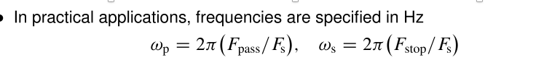
Practical filter

Slide 6
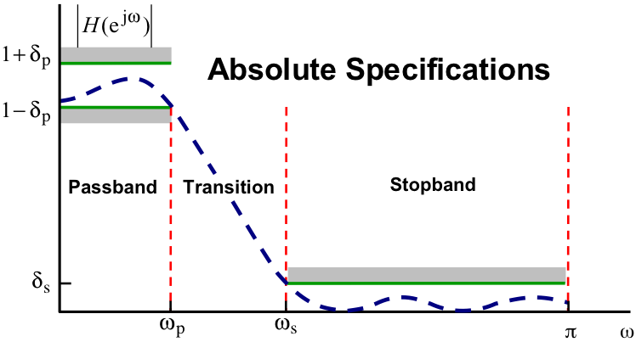
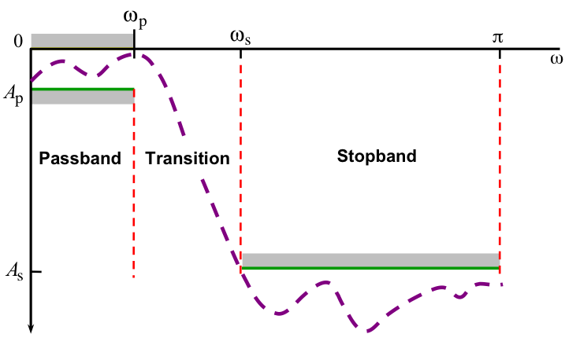
Filter Specifications
Relative Specifications

Slide 7
Bandpass filter = difference of 2 lowpass filter

Slide 8
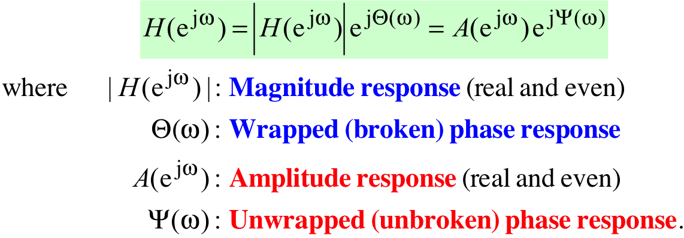
Magnitude vs. Amplitude Response
Frequency response of a linear-phase FIR filter can be written in one of two ways

Slide 9
Filter Specification

Slide 10
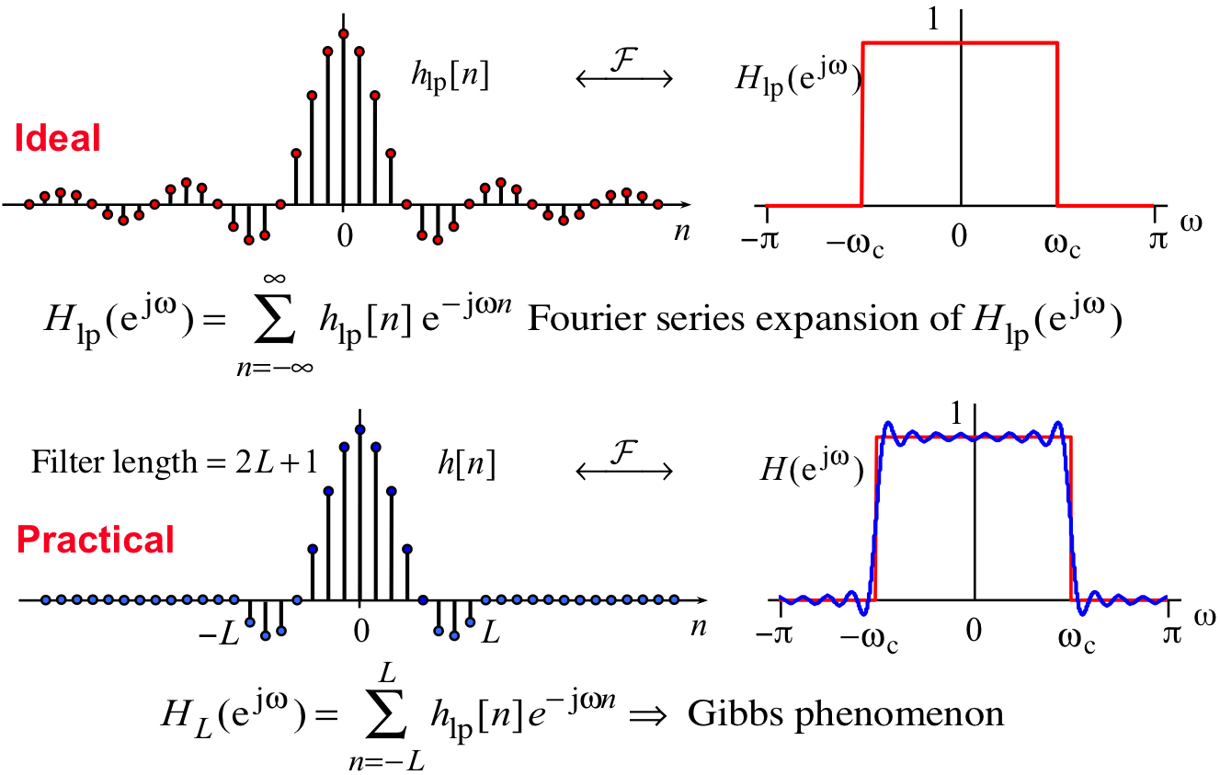
Truncating the Ideal Lowpass Filter
Notes:
Goal of practical filter design is to minimize Gibbs phenomenon as much as possible while still satisfy specification

Slide 11
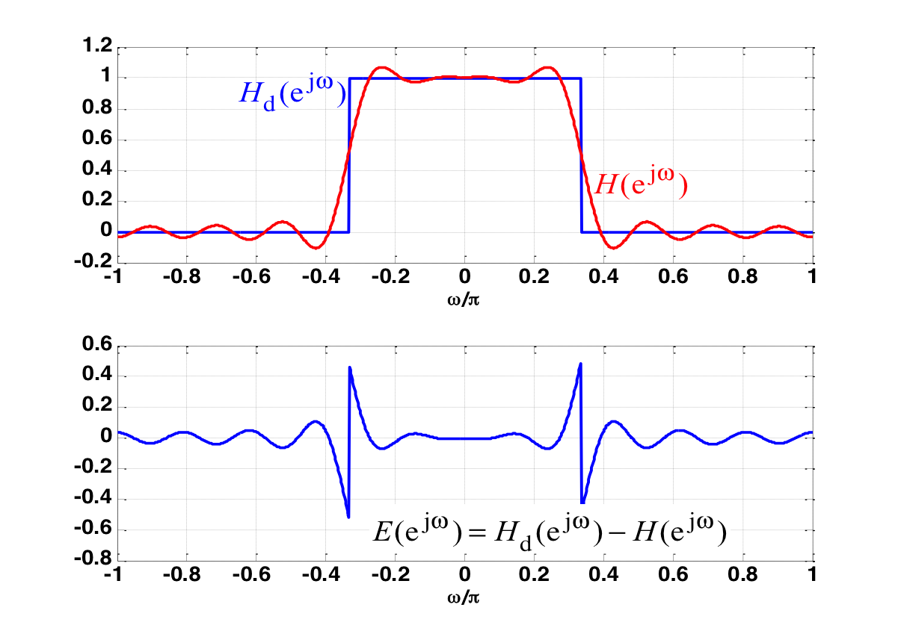
Approximation Error
Goal of filter design is to optimize the approximation error
There can be different criteria
Minimum mean-squared-error approximation
Minimax approximation

Slide 12
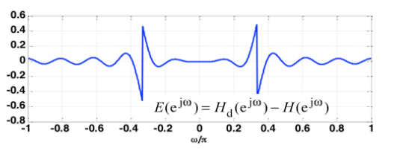
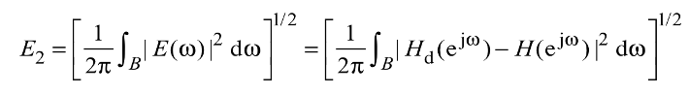
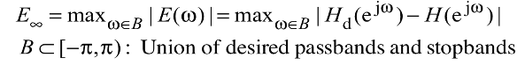
Approximation Error Criteria
Minimum mean-squared-error approximation
Design algorithm: Windowing/Kaiser method
Minimax approximation
Design algorithm: Parks-McClellan

Slide 13
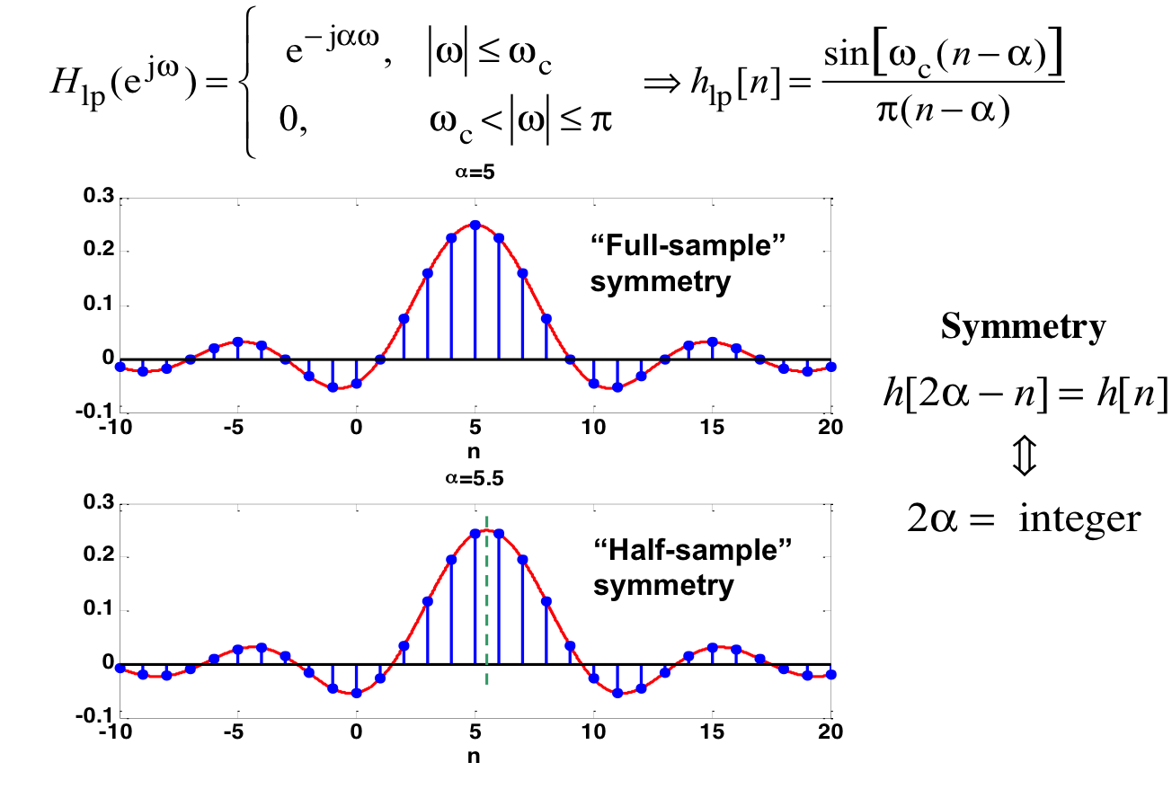
Ideal Low Pass Filter with Linear Phase
h_{lp}[n]
h_{lp}[n]

Slide 14
Symmetry in the time domain is important for phase Response
M = 2⍺ = 12
L = M+1 = 13
M = 2⍺ = 13
L = M+1 = 14
M = 2⍺ = not integer
L = M+1 = not integer

Slide 15
Causal FIR Filters with Linear Phase

Slide 16
Method 1: Window-based FIR filter
Give Type 1 (Even symmetry, M is even) or Type 2 (Even symmetry, M is odd) linear-phase FIR filter

Slide 17
Window Design of FIR Filters with Linear Phase

Slide 18
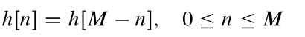
Window filter has even symmetry
M = 2⍺ = 12
h[0] = h[12-0]
M = 2⍺ = 13
h[0] = h[13-0]
M = 2⍺ = not integer
L = M+1 = not integer

Slide 19
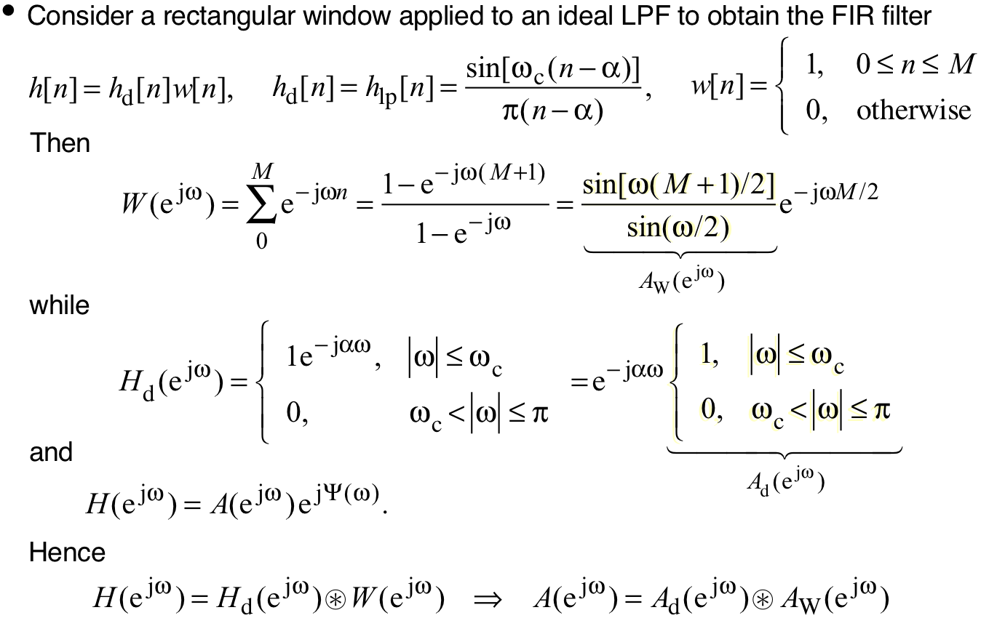
Rectangular window
h[n] is obtained from the inverse Fourier transform of $H(e^{jω})$

Slide 20
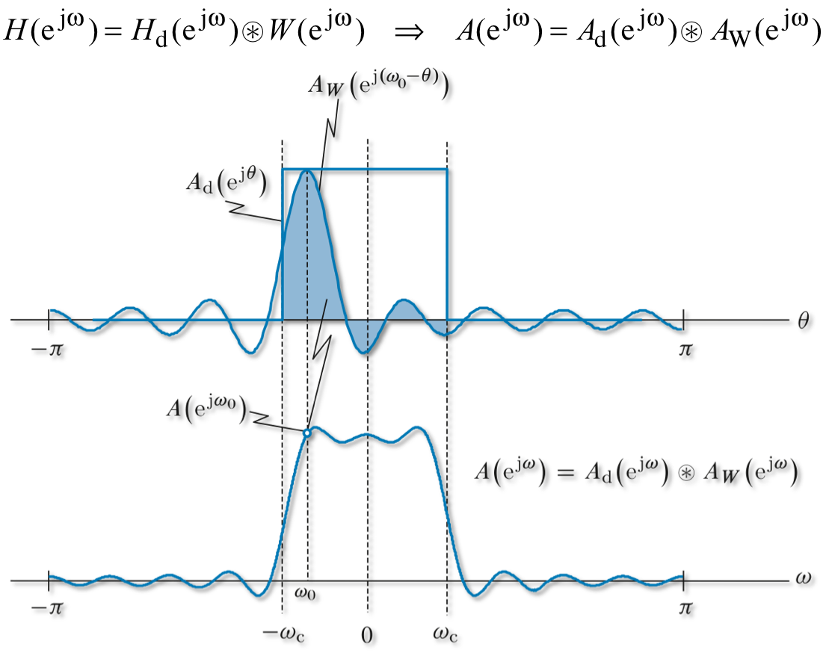
Effects of Windowing in the Frequency Domain

Slide 21
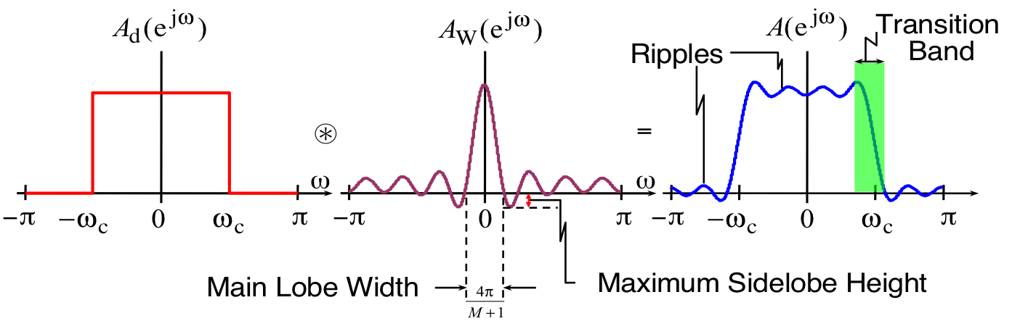
Effects of windowing in the frequency domain

Slide 22
Rectangular windows
Longer filter = skinnier main lobe and more attenuated side lobes

Slide 23
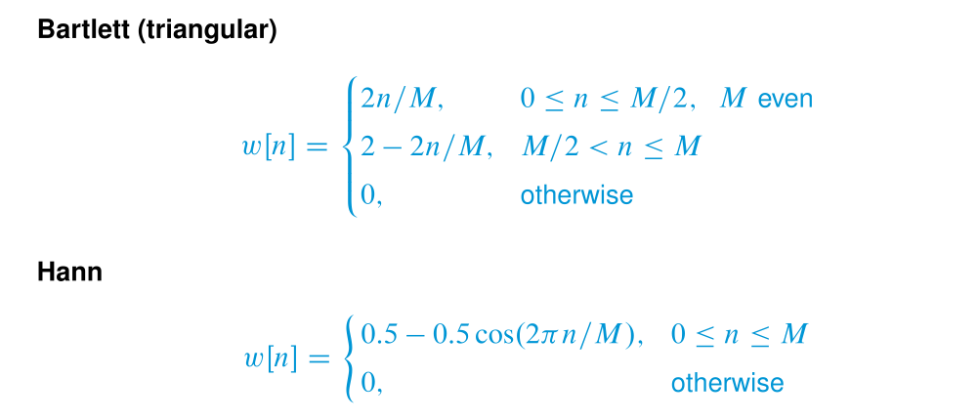
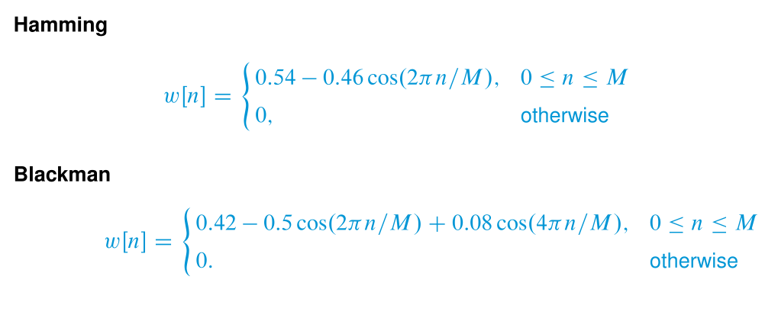
Other window responses

Slide 24
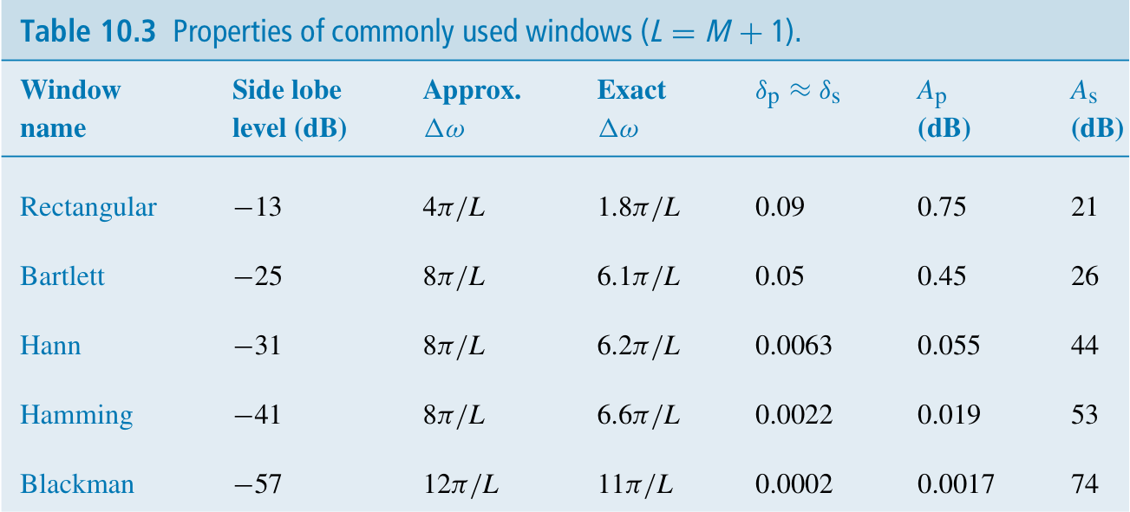
Comparison of Fixed (Attenuation) Windows

Slide 25
Matlab Functions for Fixed Windows

Slide 26
Other Matlab functions
wvtool – for looking at window functions
fvtool– for general discrete-time signals

Slide 27
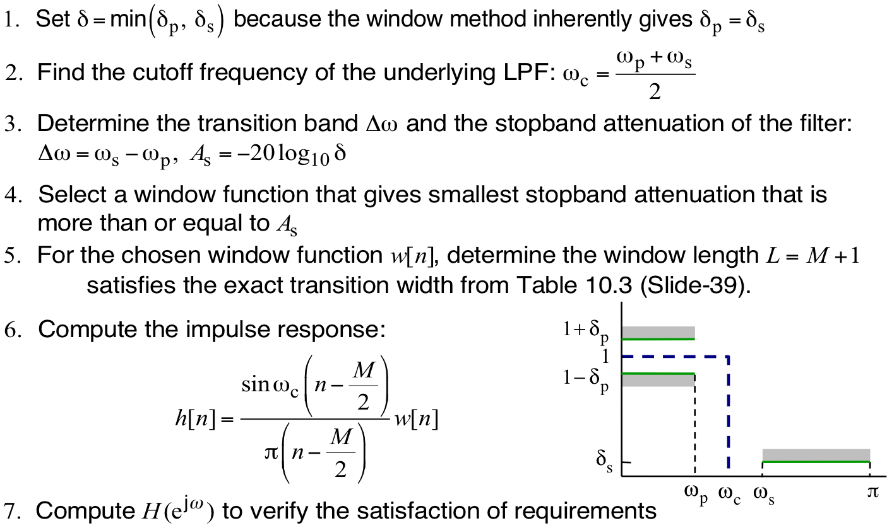
Design of Lowpass FIR filter using windows
Filter parameters:
1) Pick which window to use
2) Determine M

Slide 28
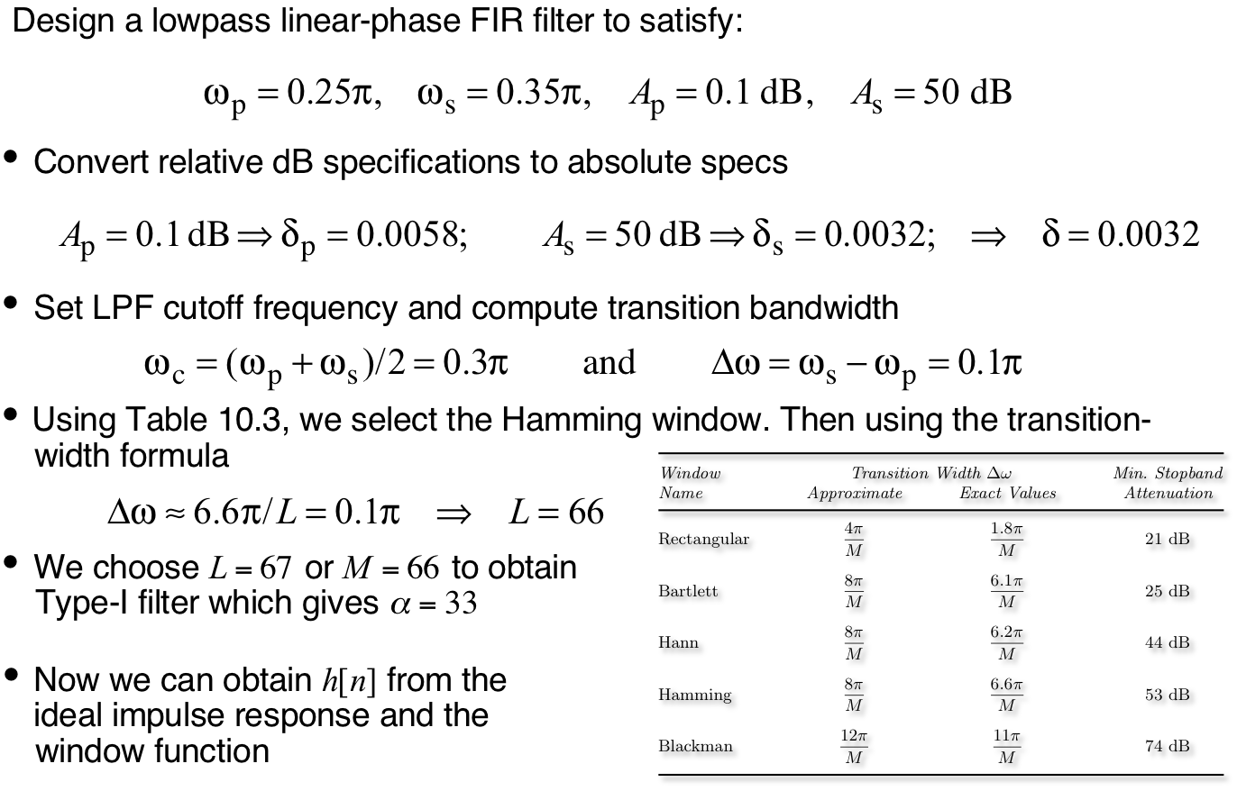
Design of Lowpass FIR filter using fixed window

Slide 29
Design of Lowpass FIR filter using fixed window
>> wp = 0.25*pi; ws = 0.35*pi; Ap = 0.1; As = 50;
>> deltap = (10^(Ap/20)-1)/(10^(Ap/20)+1);
>> deltas = (1+deltap)/(10^(As/20));
>> delta = min(deltap,deltas);
>> A = -20*log10(delta);
>> Deltaw = ws-wp; omegac = (ws+wp)/2;
>> L = ceil(6.6*pi/Deltaw)+1; % Window length
>> M=L-1; % Window order
>> n = 0:M; hd = ideallp(omegac,M);
>> h = hd.*hamming(L)';

Slide 30
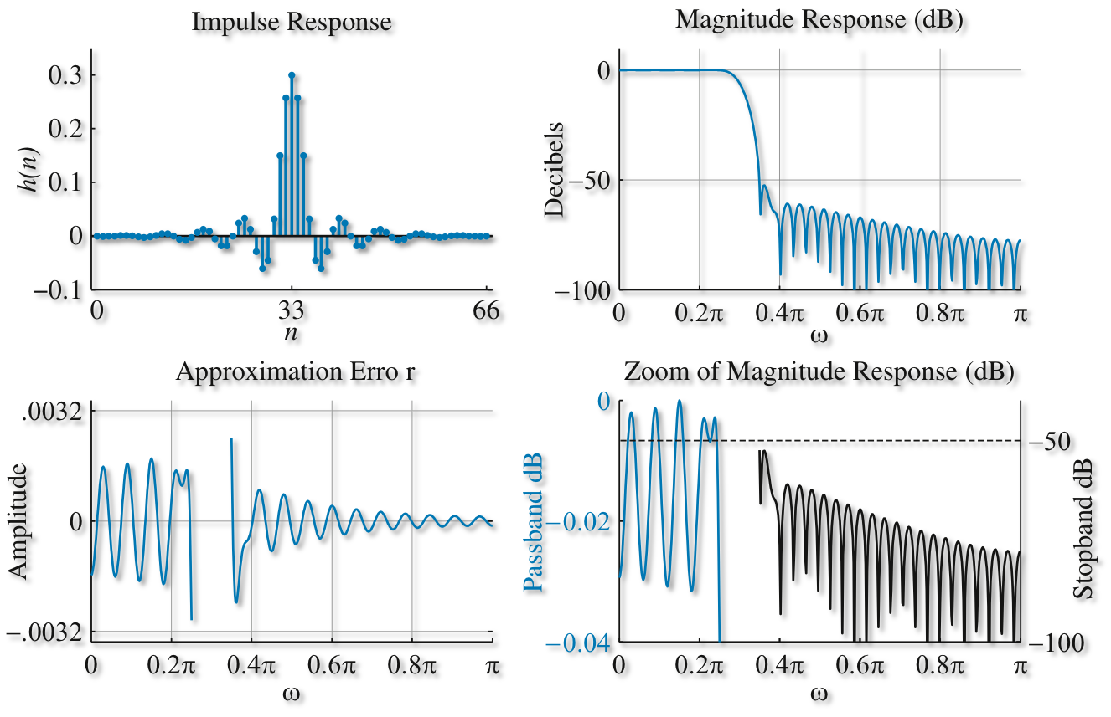
Design of Lowpass FIR filter using fixed window
M = 66

Slide 31
Kaiser window

Slide 32
Kaiser Window: Effect of Parameter 𝛽

Slide 33
Window Visualization Tool

Slide 34
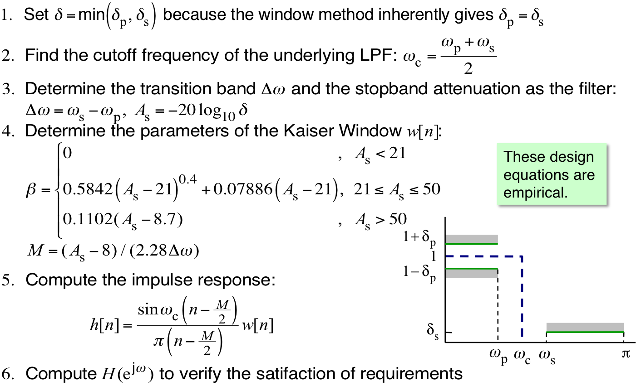
Design of Lowpass FIR filter using Kaiser Window

Slide 35
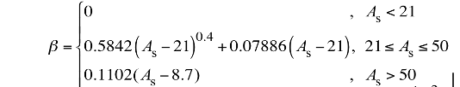
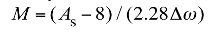
Design of Lowpass FIR filter using Kaiser Window
Filter parameters:

Slide 36
Design of Lowpass FIR filter using Kaiser Window
>> beta = 0.5842*(A-21)^(0.4)+0.07886*(A-21); % Kaiser beta
>> M = ceil((A-8)/(2.285*Deltaw))+1; % Window order
>> L = M+1; % Window length
>> alpha = M/2;
>> n = 0:M;
>> hd = wc*sinc(wc*(n-alpha));
>> h = hd.*kaiser(L,beta)';

Slide 37
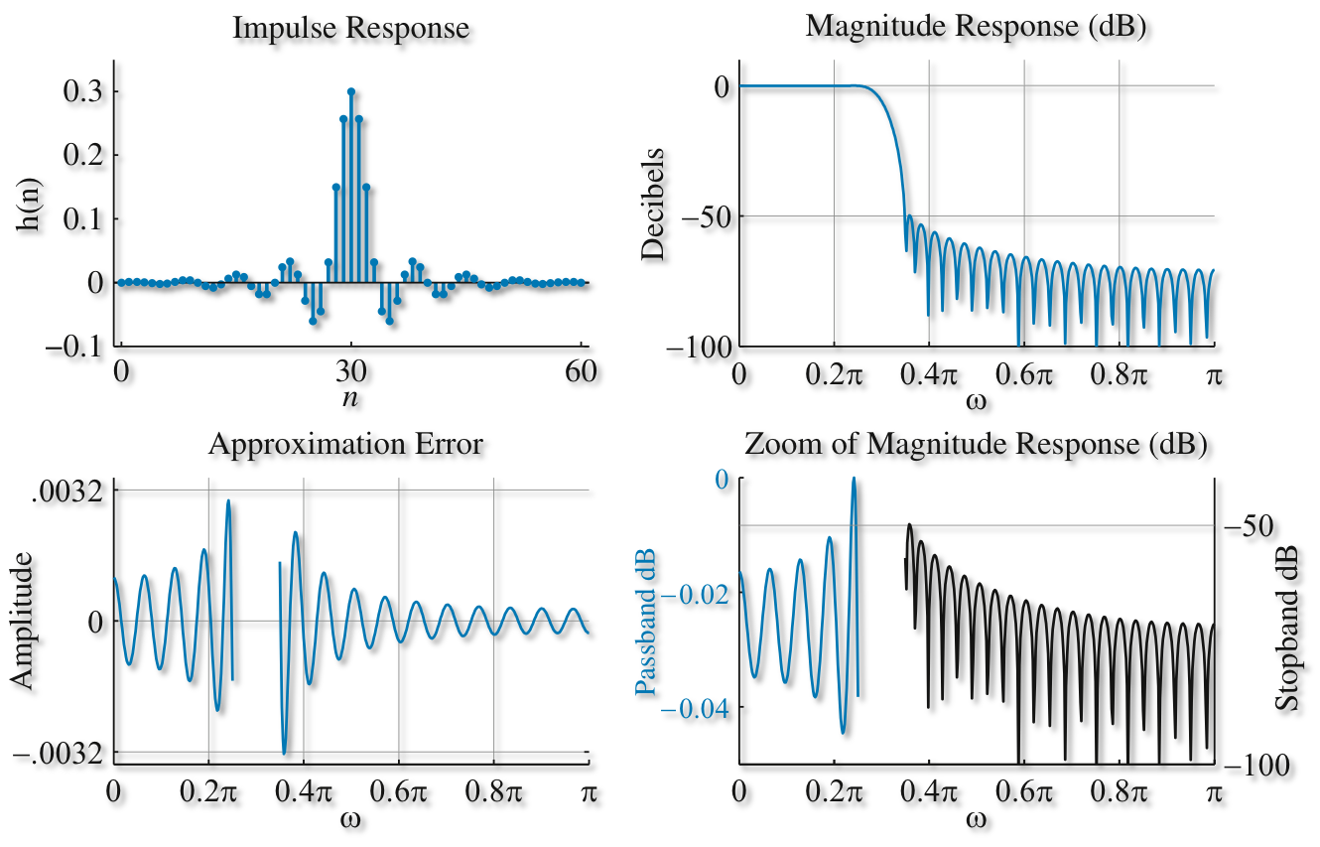
Design of Lowpass FIR filter using Kaiser Window
M = 60

Slide 38
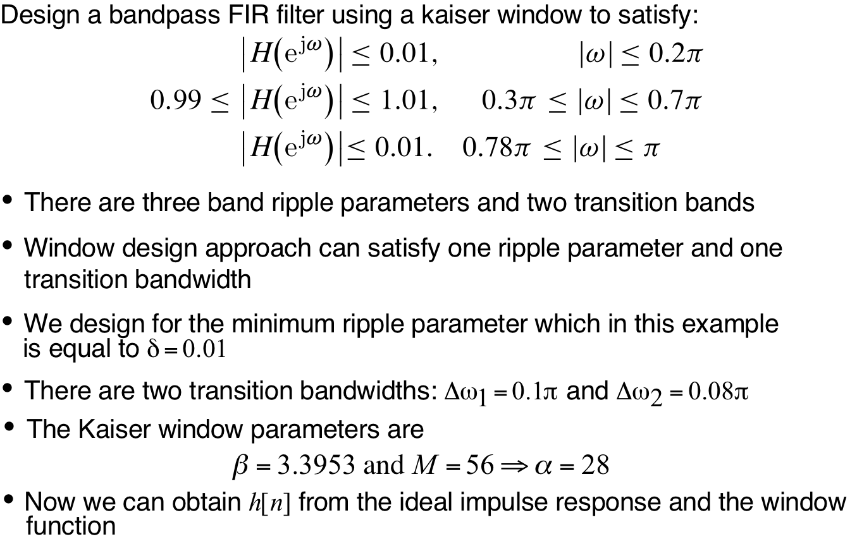
Design of Bandpass filter with Kaiser window

Slide 39
Matlab Window-Based FIR Filter Design
Syntax
b = fir1(M,Wn)
b = fir1(M,Wn,'ftype')
b = fir1(M,Wn,window)
b = fir1(M,Wn,'ftype',window)
b = fir1(...,'normalization')
[M,Wn,BTA,filtype] = kaiserord(f,A,dev,Fs)
Description
fir1 implements the classical method of windowed linear-phase FIR digital filter design. It designs filters in standard lowpass, highpass, bandpass, and bandstop configurations. By default the filter is normalized so that the magnitude response of the filter at the center frequency of the passband is 0 dB.
kaiserord determines Kaiser window parameters
Example
h = fir1(30,2*0.2,’low’) % Note that fc=Fc/Fs
fvtool(h);

Slide 40
Method 2: Parks-McClellan FIR filters
Window based filters minimizes the minimum mean-squared-error approximation error
Can only create filters with even symmetry (Type 1 and Type 2)
Parks-McClellan algorithm minimizes the minimax approximation error
Can create all 4 types of filters
Parks-McClellan algorithm guarantees that the maximum approximation error will not go above a certain threshold

Slide 41
Flavor of how Parks-McClellan algorithm works
Goal:
See notes

Slide 42
Matlab Functions

Slide 43
Use firpmord first to obtain rough M approximation

Slide 44
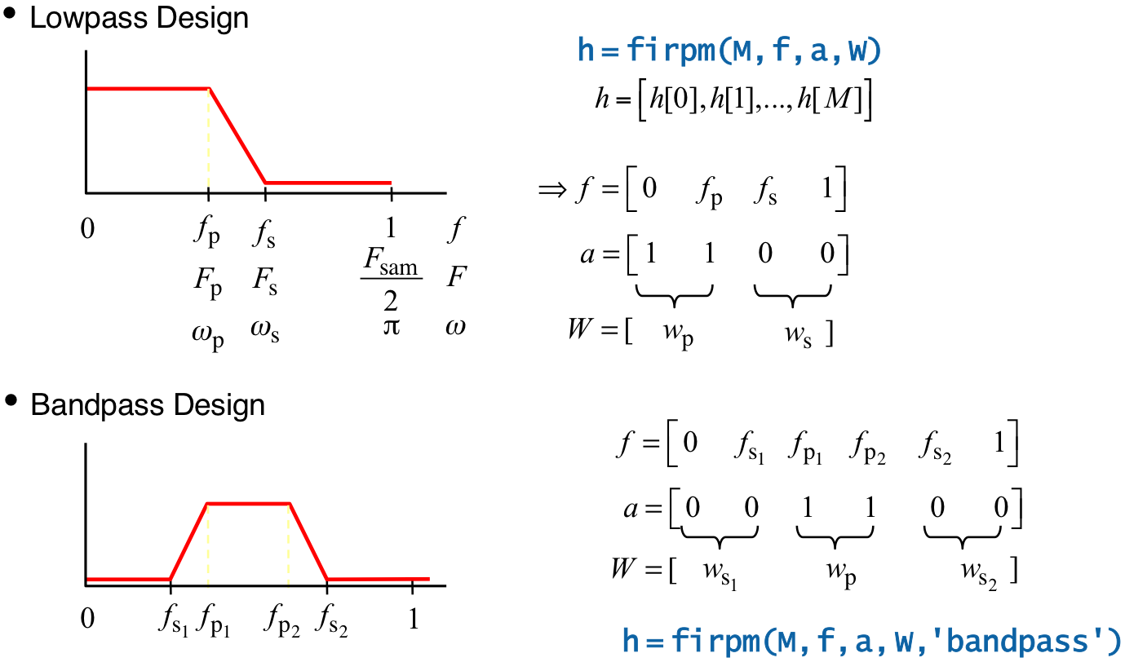
Examples of firpm parameters

Slide 45
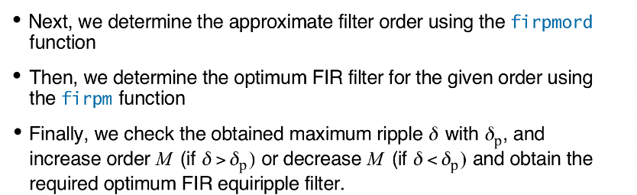
Design of Lowpass FIR filter using Park-McClellan

Slide 46
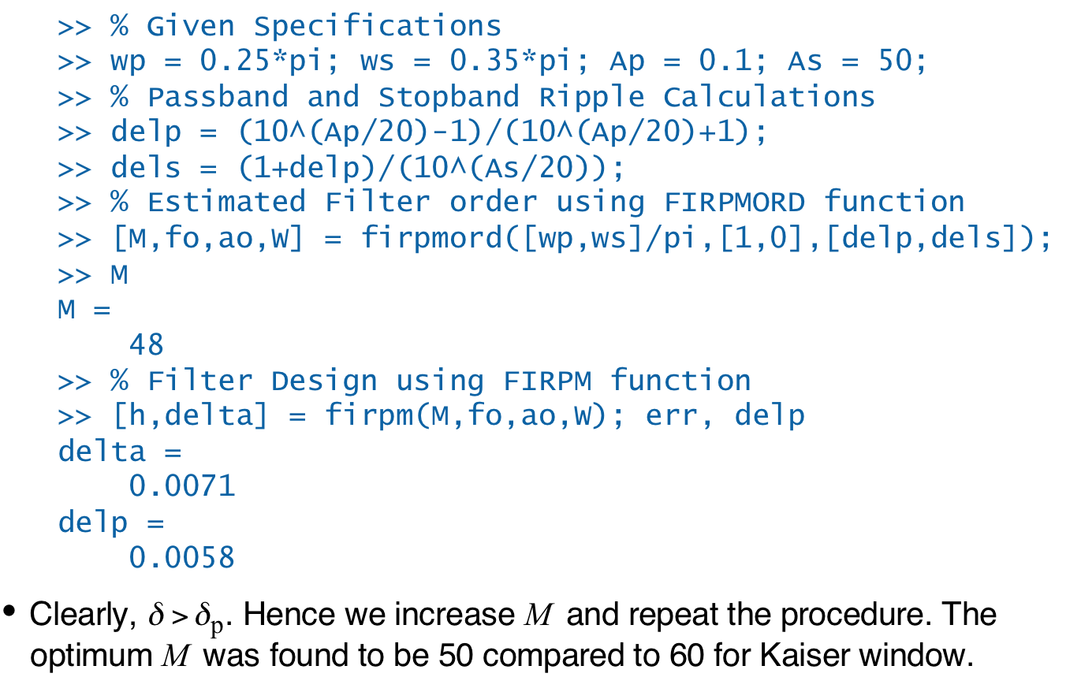
Design of Lowpass FIR filter using Park-McClellan

Slide 47
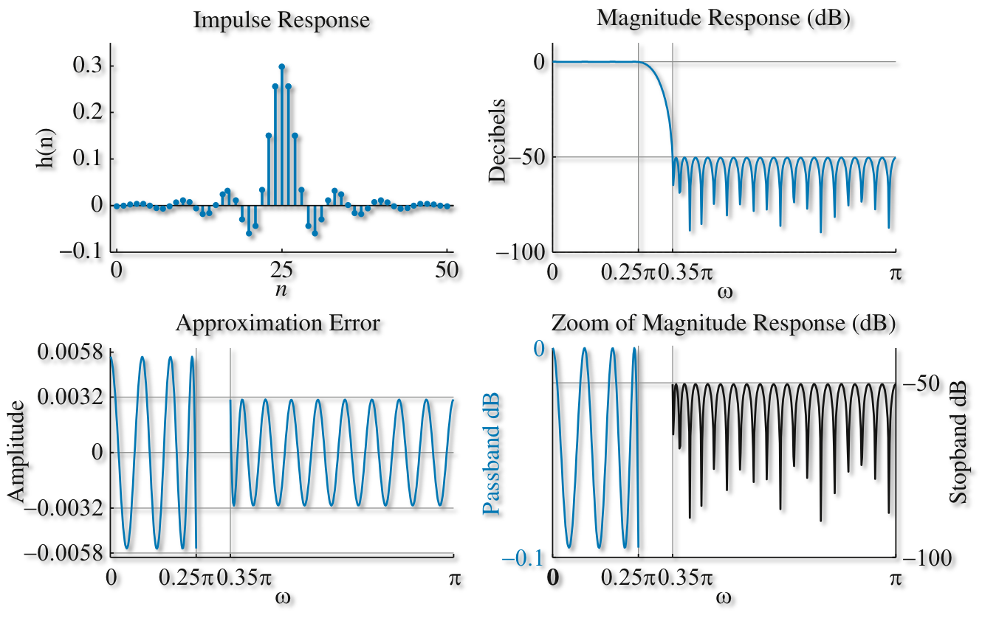
Design of Lowpass FIR filter using Park-McClellan
M = 50

Slide 48
Design of Bandpass FIR filter using Park-McClellan
First estimate filter order using FIRPMORD function
Band-edge array is now f = [ws1, wp1, wp2, ws2]/pi
Band-edge designed gain is a = [0,1,0]
Using function FIRPM with the estimated M
When you compare performance, compare the tolerance (delta) of designed filter with the left most band tolerance. In this case, delta of the first stopband is 0.01.

